Slide 1
Microservices Data Consistency Approaches: A tailored approach towards current limitations
Final Proposal Defense
Asim Riaz
1732102
Supervisor:
Dr. Husnain Mansoor Ali

Slide 2
Contents
Introduction
Microservices Architecture
Microservices Issues
Data Consistency Issue
Problem Statement
Research Objectives
Literature Review
Research Questions
Methodology
Research Roadmap
References
Q&A

Slide 3
Introduction
Microservices have become a popular architectural style for data driven applications, given their ability to functionally decompose an application into small and autonomous services to achieve scalability, strong isolation, and specialization of database systems to the workloads and data formats of each service. [1,2]

Slide 4
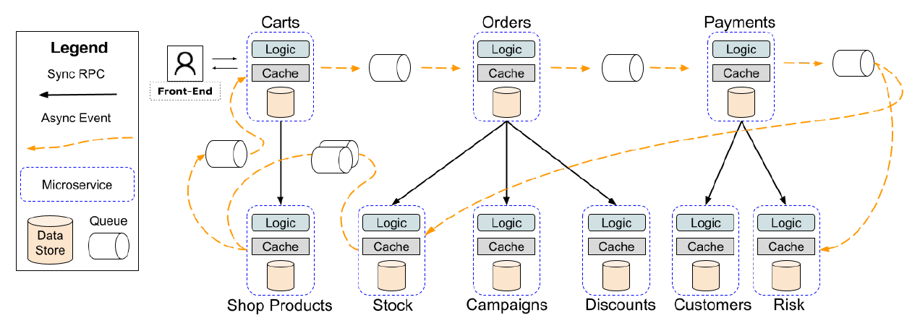
Microservice Architecture

Slide 5
Microservices Issues
Research has identified 17 area of issues in a microservices architecture style [3].
In which to most critical is data related issues. Which directly impact the performance of whole architecture.
In this study is focused about data consistency in microservices.

Slide 6
Data Consistency Issues
Cross Microservice Validations [1,2,3]
Implicit Cross Microservice Associations[1,3]
Cross Microservice Queries [3]
Feral ordering[24]

Slide 7
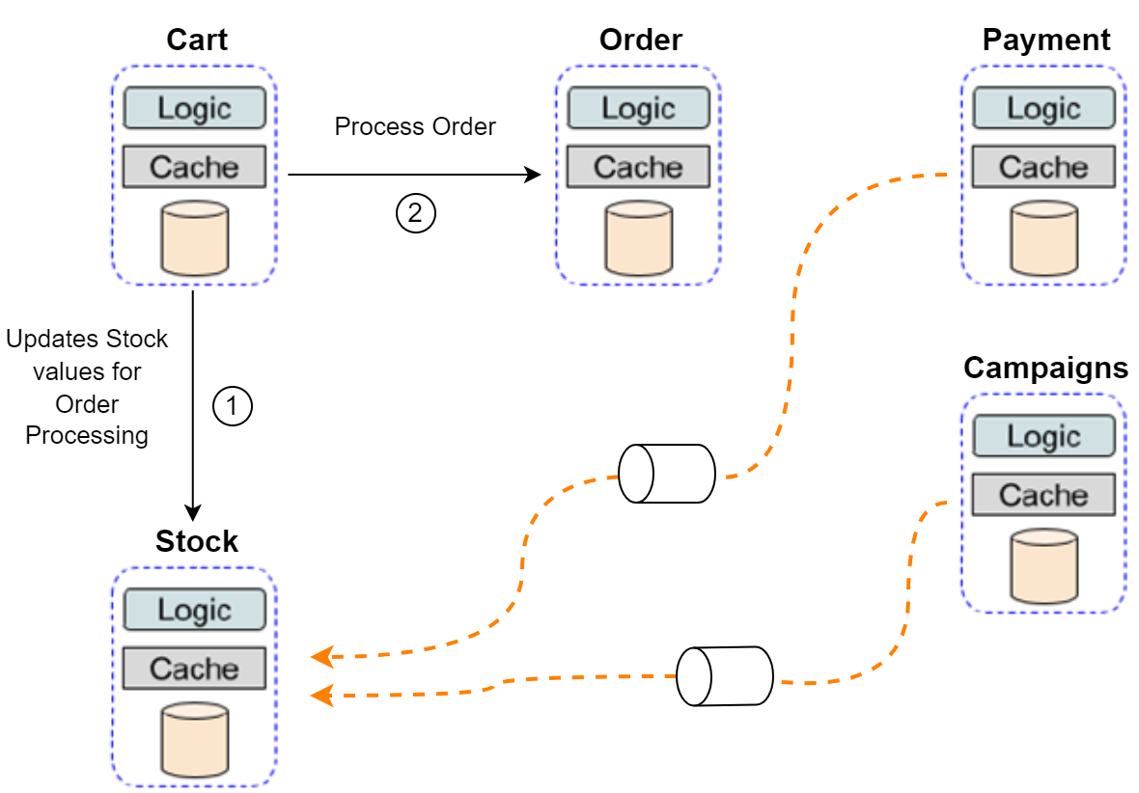
Data Consistency Issues: Cross Microservice Validations

Slide 8
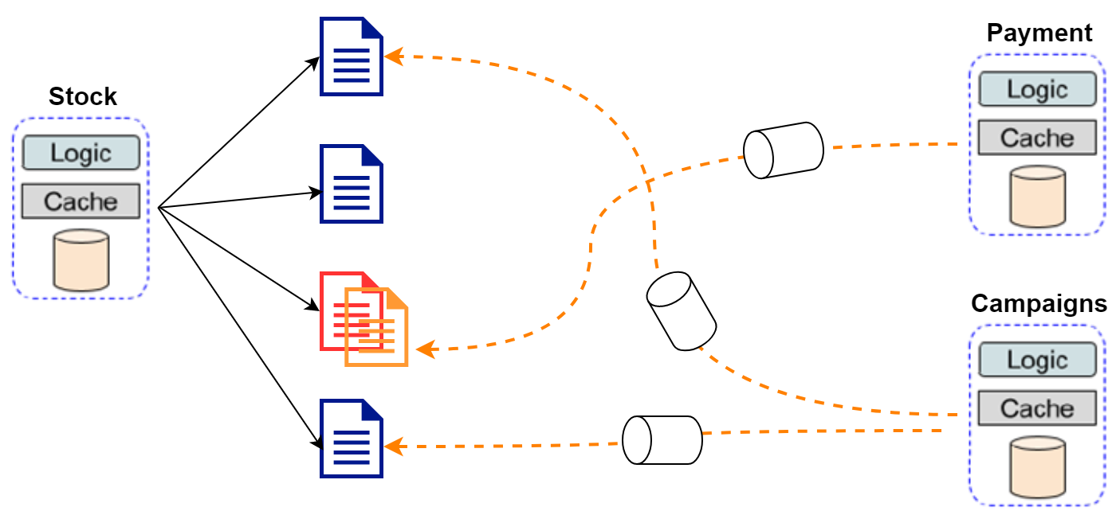
Data Consistency Issues: Implicit Cross Microservice Associations

Slide 9
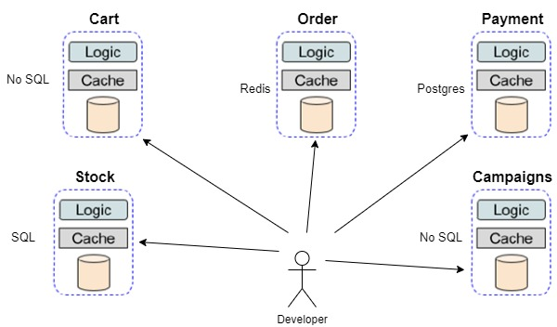
Data Consistency Issues: Cross Microservice Queries

Slide 10
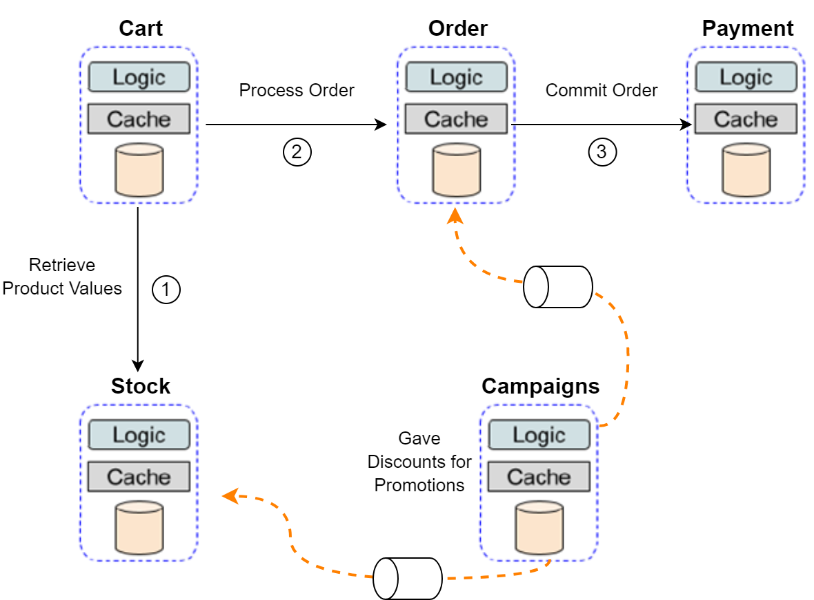
Data Consistency Issues: Feral Ordering

Slide 11
Problem Statement
Software industry heavily relies on custom data consistency implementations while using microservice architecture
Industry have multiple microservices data consistency approaches available at their disposal, however, their adaption is limited
This research will:
Pursue to identify the limitation of existing microservices data consistency approaches
Segregate the limitations that hinder the adaptation of microservices data consistency approaches by industry
Propose potential solutions to overcome selected limitations to increase industry adaptation of microservices data consistency approaches

Slide 12
Research Objectives
Evaluate limitations of microservices data consistency approaches for industry adaptation
Design and proposed adaptation model.
Testing and evaluation of proposed adaptation model.

Slide 13
Literature Review
Research Papers | Author(s) | Year | Description
Data Management in Microservices: State of the Practice, Challenges, and Research Directions | Rodrigo Laigner, Yongluan Zhou | 2021 | An investigation of the state of the practice and challenges practitioners face regarding data management in microservices is lacking. To bridge this gap, They conducted a systematic literature review of representative articles reporting the adoption of microservices in open-source paradigm. It is used to categorize the state of practice of data management in microservices and observe several foundational challenges
Microservice Practices Reconsidered in Industry | Qilin Xiang, Xin Peng, Chuan He, Hanzhang Wang, Tao Xie, Dewei Liu, Gang Zhang, and Yuanfang Cai | 2021 | Microservice systems implemented in industry vary a lot in terms of adopted practices and achieved benefits, drastically different from what is advocated in the literature. They conduct an empirical study, including an online survey with 51 responses and 14 interviews for experienced microservice experts to advance our understanding regarding to microservice practices in industry
On the Nature of Issues in Five Open Source Microservices Systems: An Empirical Study | Muhammad Waseem1, Peng Liang1∗, Mojtaba Shahin2, Aakash Ahmad3, Ali Rezaei Nasab4 | 2021 | There is a limited evidence-based and thorough understanding of the types of issues (e.g., faults, errors, failures, mistakes) faced by microservices system developers and causes that trigger the issues. Such evidence-based understanding of issues and causes is vital for long-term, impactful, and quality research and practice in the MSA style.
Enforcing Consistency in Microservice Architectures through Event-based Constraints | Rodrigo Laigner, Yongluan Zhou | 2021 | Decomposition of an application into small and independent components, in which each encapsulating its own state and communicating via asynchronous events, new components and events can be easily integrated into the system. However, by pursuing a model where events are generated and processed at the application-level, developers have a hard time to safeguard arbitrary event interleaving`s from doing harm to application safety.

Slide 14
Literature Review (Cont.)
Research Papers | Author(s) | Year | Description
Performance Analysis of Microservices Design Patterns | Akhan Akbulut, Member, IEEE, and Harry G. Perros, Fellow, IEEE | 2019 | Business interest in microservices is increasing since the microservices architecture brings a lightweight, independent, reuse-oriented, and fast service deployment approach that minimizes infrastructural risks. This approach is at an early stage of its development, and in view of this, it is important to understand the performance of its design patterns
Evaluation of Data Storage Patterns in Microservices Archicture | Munonye K*, Martinek P** | 2020 | In this research, we would examine five possible data storage patterns for microservices. The evaluation would include setting up prototypes and evaluating the performance of both RDBMS and document-store enabled data stores for microservice architecture.
2PC - a distributed transaction concurrency control protocol of multi-microservice based on cloud computing platform | Pan Fan1, Jing Liu1*, Wei Yin2, Hui Wang2, Xiaohong Chen1 and Haiying Sun1 | 2020 | The two-phase commit (2PC) protocol is a key technique for achieving distributed transactions in storage systems such as relational databases and distributed databases. 2PC is a strongly consistent and centralized atomic commit protocol that ensures the serialization of the transaction execution order.
SagaMAS: a software framework for distributed transactions in the microservice architecture | Xavier Limon´ ∗, Alejandro Guerra-Hernandez ´ †, Angel J. Sanchez-Garc ´ ´ıa‡, Juan Carlos Perez Arriaga ´ § | 2018 | Each microservice can have different implementations and data persistence technologies, resulting in heterogeneous distributed systems. Given its heterogeneity and distributed nature, an open challenge in this architecture is the proper management of distributed transactions that expand through several microservices.

Slide 15
Research Questions
What are the current limitations of microservices based data consistency approaches, and what adequacies are required to be addressed?
How will proposed adaptation model cater towards the limitations of the current microservices practices?
Which testing criteria and evaluation techniques be suitable to assess the proposed adaptation model?

Slide 16
Methodology
Ascertain the limitations of data consistency in microservices Implementations.
Evaluate and assess the limitations of the determined microservice approaches via Gap Analysis
Develop an Adaptation model for facilitating microservice approaches.
Evaluation of the Adaptation model for both theoretical and practical simulations.

Slide 17
Research Roadmap
Microservices
Data Consistency Approaches
Industry
Adaptations
of
Microservices
Implementation
Limitations of Adaptation
Adaptation Model
Sagas
Pros & Cons
2PC
Gaps
SEATA
Testing
Theoretical
Practical

Slide 18
Contribution
Contributions offered in this research is as follows:
Assess the current limitations of microservices and their practices.
Offer an Adaptation Model that will facilitate the microservices architecture towards the Industrial standards.
An effective evaluation criteria for determining the suitability of microservices with the industrial practices, through theoretical and practical results.

Slide 19
References
Laigner, R., Zhou, Y., Salles, M.A.V., Liu, Y. and Kalinowski, M., 2021. Data Managementin Microservices: State of the Practice, Challenges, and Research Directions. arXiv preprintarXiv:2103.00170.
Xiang, Q., Peng, X., He, C., Wang, H., Xie, T., Liu, D., Zhang, G. and Cai, Y.,2021. No Free Lunch: Microservice Practices Reconsidered in Industry. arXiv preprintarXiv:2106.07321.
Waseem, M., Liang, P., Shahin, M., Ahmad, A. and Nassab, A.R., 2021. On the Nature ofIssues in Five Open Source Microservices Systems: An Empirical Study. In Evaluation andAssessment in Software Engineering (pp. 201-210).
Ba ̊A¡karada, S., Nguyen, V. and Koronios, A., 2018. Architecting microservices: Practicalopportunities and challenges. Journal of Computer Information Systems.
Laigner, R., Kalinowski, M., Diniz, P., Barros, L., Cassino, C., Lemos, M., Arruda, D., Lif-schitz, S. and Zhou, Y., 2020, August. From a monolithic big data system to a microservicesevent-driven architecture. In 2020 46th Euromicro Conference on Software Engineering andAdvanced Applications (SEAA) (pp. 213-220). IEEE.
Lesniak, A., Laigner, R. and Zhou, Y., 2021, June. Enforcing consistency in microservicearchitectures through event-based constraints. In Proceedings of the 15th ACM InternationalConference on Distributed and Event-based Systems (pp. 180-183).
Akbulut, A. and Perros, H.G., 2019. Performance analysis of microservice design patterns.IEEE Internet Computing, 23(6), pp.19-27.
Munonye, K. and Martinek, P., 2020, June. Evaluation of Data Storage Patterns in Mi-croservices Archicture. In 2020 IEEE 15th International Conference of System of SystemsEngineering (SoSE) (pp. 373-380). IEEE.
Daja, D., 2020. Data Transformation: An Overview.
Laigner, R., Zhou, Y. and Salles, M.A.V., 2021, June. A distributed database system forevent-based microservices. In Proceedings of the 15th ACM International Conference onDistributed and Event-based Systems (pp. 25-30).

Slide 20
References
Bailis, P. and Ghodsi, A., 2013. Eventual consistency today: limitations, extensions, andbeyond. Communications of the ACM, 56(5), pp.55-63.
Di Francesco, P., Lago, P. and Malavolta, I., 2018, April. Migrating towards microser-vice architectures: an industrial survey. In 2018 IEEE International Conference on SoftwareArchitecture (ICSA) (pp. 29-2909). IEEE.
Taibi, D., Lenarduzzi, V. and Pahl, C., 2017. Processes, motivations, and issues for mi-grating to microservices architectures: An empirical investigation. IEEE Cloud Computing,4(5), pp.22-32.15
Zhang, H., Li, S., Jia, Z., Zhong, C. and Zhang, C., 2019, March. Microservice archi-tecture in reality: An industrial inquiry. In 2019 IEEE international conference on softwarearchitecture (ICSA) (pp. 51-60). IEEE.
Haselb ̃A¶ck, S., Weinreich, R. and Buchgeher, G., 2018, November. An expert interviewstudy on areas of microservice design. In 2018 IEEE 11th Conference on Service-OrientedComputing and Applications (SOCA) (pp. 137-144). IEEE.
Bogner, J., Fritzsch, J., Wagner, S. and Zimmermann, A., 2019, March. Microservices inindustry: insights into technologies, characteristics, and software quality. In 2019 IEEE in-ternational conference on software architecture companion (ICSA-C) (pp. 187-195). IEEE.
Ntentos, E., Zdun, U., Plakidas, K., Schall, D., Li, F. and Meixner, S., 2019, September.Supporting architectural decision making on data management in microservice architectures.In European Conference on Software Architecture (pp. 20-36). Springer, Cham.
Shadija, D., Rezai, M. and Hill, R., 2017, September. Towards an understanding of mi-croservices. In 2017 23rd International Conference on Automation and Computing (ICAC)(pp. 1-6). IEEE.
seata.io. (n.d.). Seata. [online] Available at: https://seata.io/en-us/ [Accessed 2 Feb. 2022].
Fan, P., Liu, J., Yin, W., Wang, H., Chen, X. and Sun, H., 2020. 2PC*: a distributedtransaction concurrency control protocol of multi-microservice based on cloud computingplatform. Journal of Cloud Computing, 9(1), pp.1-22

Slide 21
Question & Answer Session
Thank you

